Slide 1
Harnessing FinBERT as a Market Sentiment Signal for Meta-Model Predictions
Integrating FinBERT-Derived Sentiment into Meta-Model Predictions

Slide 2
Introduction
Ensemble models can improve predictive accuracy (Zhou, 2012).
Base models often miss external context such as market sentiment.
FinBERT sentiment scores can serve as exogenous predictors.

Slide 3

Transformers Overview
Transformer architecture introduced by Vaswani et al. (2017).
Relies on self-attention to capture long-range dependencies.
Parallelizable → efficient for NLP tasks.
Pretrained models can be fine-tuned for domain-specific applications.

Slide 4

PyTorch for Deep Learning
PyTorch for Deep Learning
Open-source deep learning framework (Paszke et al., 2019).
Dynamic computation graph → flexible for research.
Strong integration with Hugging Face Transformers library.
GPU acceleration for training and inference.

Slide 5

What is FinBERT?
Transformer model based on BERT architecture.
Fine-tuned for financial text sentiment analysis (Araci, 2019).
Classifies sentiment as positive, negative, or neutral.
Trained on financial reports, news, and market commentary.

Slide 6

Market Sentiment as an Exogenous Variable
Exogenous variables = predictors external to model’s endogenous features.
Captures information unavailable in historical numerical features.
Financial sentiment influences price movement (Tetlock, 2007).
Adding this to meta-model augments base models’ limited feature set.

Slide 7

Why Base Models Don’t See This Signal
Base models trained solely on price, volume, and technical indicators.
Lack textual or event-driven inputs.
Cannot infer sentiment shifts from purely numeric data.

Slide 8
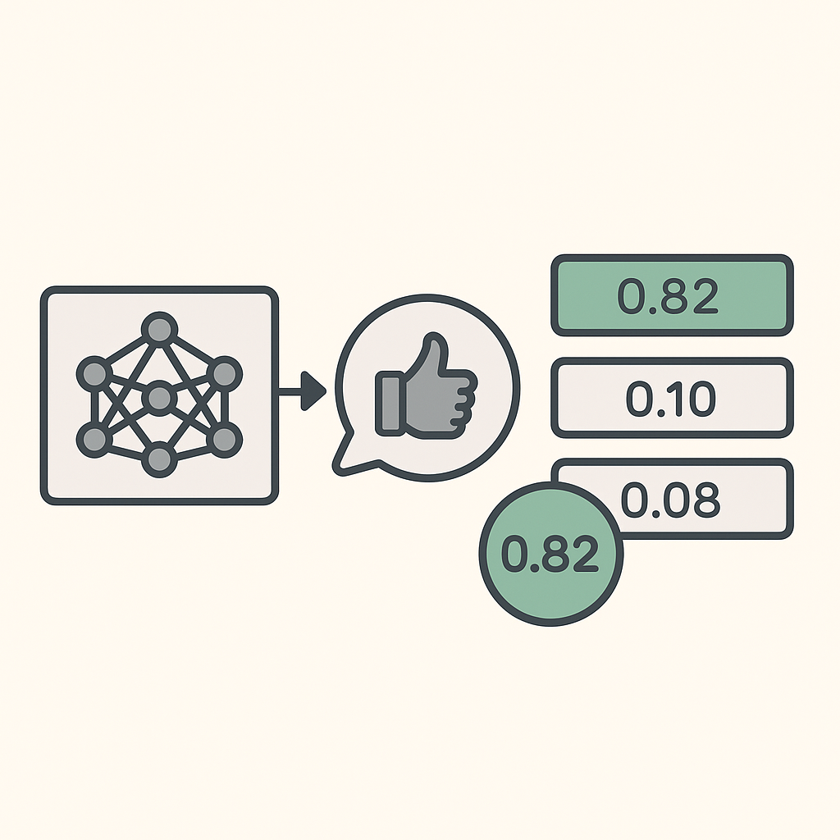
FinBERT Output and Confidence
FinBERT outputs:
Sentiment label.
Probability scores for each sentiment class.
Probability score of predicted class = confidence signal.
This score can be added as a numeric feature in meta-model input.

Slide 9
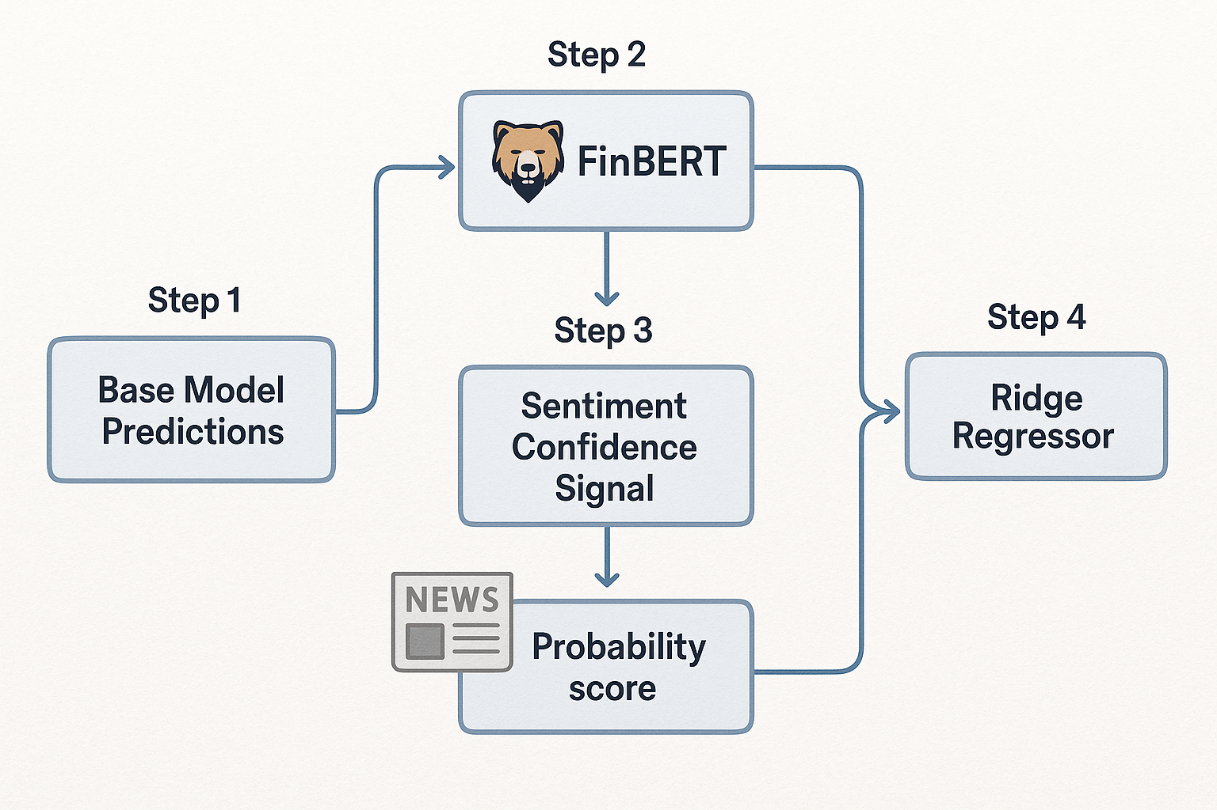
Integrating Confidence Signal into Meta-Model
Step 1: Generate base model predictions (e.g., TensorFlow Sequential models).
Step 2: Use FinBERT to score same-day financial news or market headlines.
Step 3: Extract predicted sentiment probability → append as extra feature.
Step 4: Ridge regressor (or other meta-model) trains on both:
Base model predictions.
Sentiment confidence signal.

Slide 10
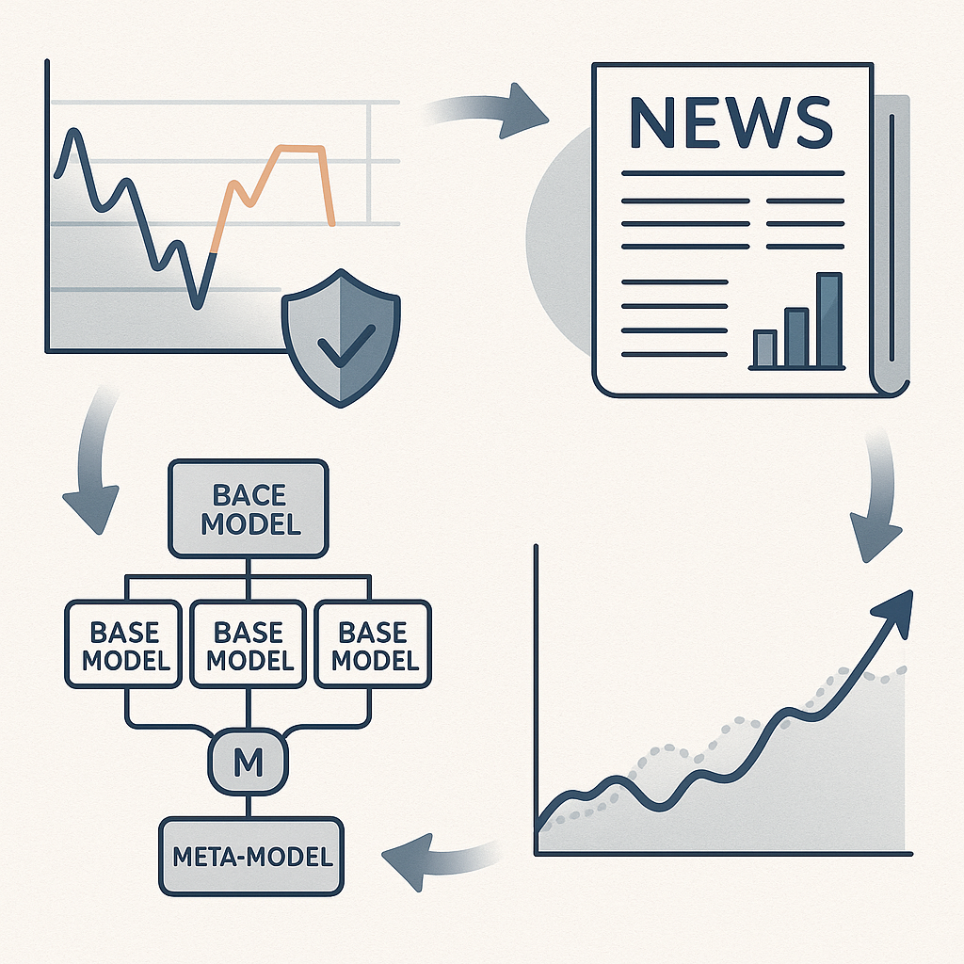
Advantages of Adding the Signal
Improves prediction robustness during sentiment-driven volatility.
Captures qualitative market drivers that numeric models ignore.
Can improve responsiveness to sudden news events.
Helps meta-model learn context-dependent weighting of base models.

Slide 11
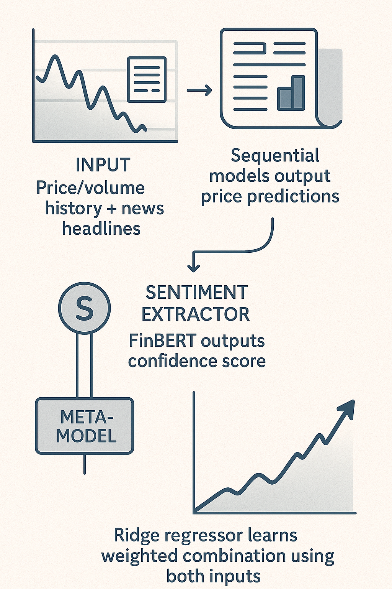
Example Workflow
Input: Price/volume history + news headlines.
Base models: Sequential models output price predictions.
Sentiment extractor: FinBERT outputs confidence score.
Meta-model: Ridge regressor learns weighted combination using both inputs.

Slide 12

Conclusion
Transformers (FinBERT) bring unstructured text into structured prediction workflows.
Sentiment confidence score is a valuable exogenous predictor.
Integration into meta-model can boost accuracy, especially in news-sensitive markets.

Slide 13
THANK YOU
References
Araci, D. (2019). FinBERT: Financial sentiment analysis with pre-trained language models. arXiv preprint arXiv:1908.10063.
Paszke, A., Gross, S., Massa, F., Lerer, A., Bradbury, J., Chanan, G., … Chintala, S. (2019). PyTorch: An imperative style, high-performance deep learning library. Advances in Neural Information Processing Systems, 32, 8024–8035.
Tetlock, P. C. (2007). Giving content to investor sentiment: The role of media in the stock market. The Journal of Finance, 62(3), 1139–1168.
Vaswani, A., Shazeer, N., Parmar, N., Uszkoreit, J., Jones, L., Gomez, A. N., … Polosukhin, I. (2017). Attention is all you need. Advances in Neural Information Processing Systems, 30.
Zhou, Z. H. (2012). Ensemble methods: Foundations and algorithms. CRC Press.
Patrick Hill
phill86037@uat.edu
August 13, 2025
Note: Illustrations were created by ChatGPT 5

